Slide 1
Cloud Gaming : Understanding Support from the virtualization and hardware
Gautam Krishna R
Roll No: 28 | CSE S7

Slide 2
Overview
Introduction
Cloud gaming
Types of Cloud Gaming
Architecture
Advantages
Challenges
Virtualization
Introduction
Design and Implementation
Conclusion and outlook

Slide 3
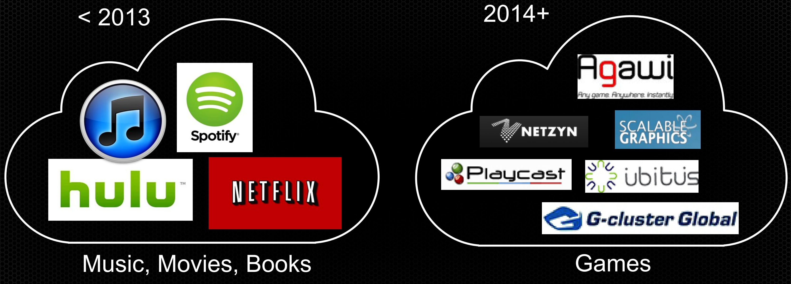
Introduction
Everything on the cloud….

Slide 4
Cloud Gaming
Cloud gaming, sometimes called gaming on demand
Cloud gaming, in its simplest form, renders an interactive gaming application remotely in the cloud and streams the scenes as a video sequence back to the player over the Internet.
Two types:
Video (or pixel) streaming
File streaming

Slide 5
Type :1 Video streaming
The actual game is stored, executed, and rendered on the remote operator's or game company's server.
The video results are streamed directly to a consumer's computers over the internet using thin client.
Keystrokes and button presses are sent directly to the server
Server sends back the game response
Allows access to games without the need of a Consoles or High end PC

Slide 6
Type 2: File streaming
Also known as progressive downloading.
A small part of a game, usually less than 5% of the total game size is downloaded to the user’s device.
The remaining game content is downloaded to the end user's device while playing.
Rendering and processing takes place in user’s PC or console.
This allows instant access to games with low bandwidth Internet connections.

Slide 7
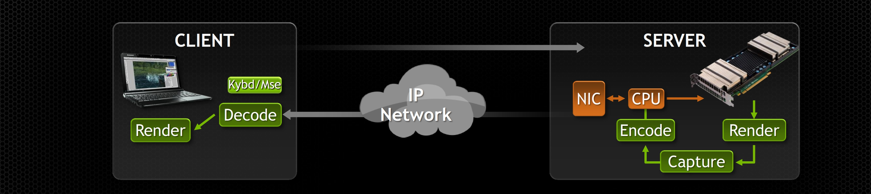
aRCHITECTURE

Slide 8
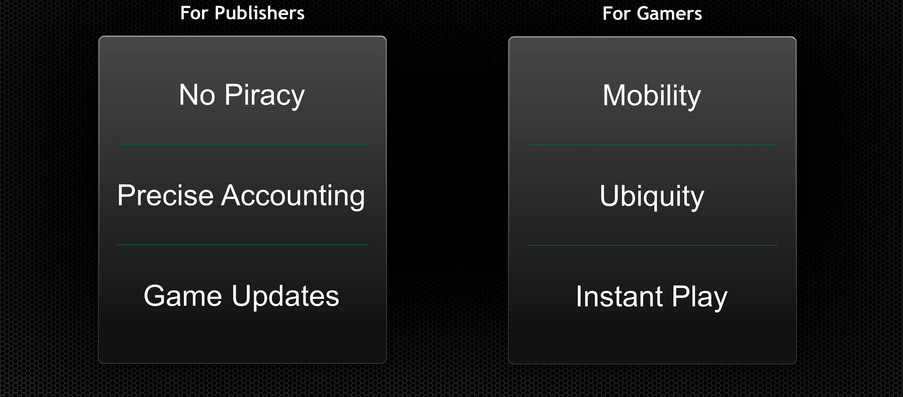
Advantages

Slide 9
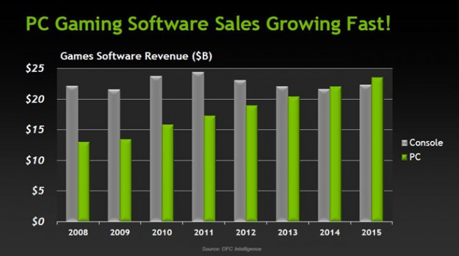
PC v/s Console

Slide 10
Challenges
Currently most of the cloud gaming platforms private/public non-virtualized environment.
Each users have his on clusters in the cloud.
Costs to maintain private environment is high
Deployment costs will be high

Slide 11
The Solution: Virtualization
A virtualized cloud environment refers to a cloud cluster that can be easily scaled.
Each user have his own virtualized cloud environment
Maintenance cost is low
Deployment cost is low

Slide 12
DESIGN AND IMPLEMENTATION
Recent advancement in technology created new classes of GPUs speciﬁcally for virtualized environments.
E.g.: NVIDIA GRID
Implementation of a high performance cloud gaming system: Rhizome
With NVIDIA GRID GPU and its hardware H.264 encoder.
The gaming protocol can be customized.

Slide 13
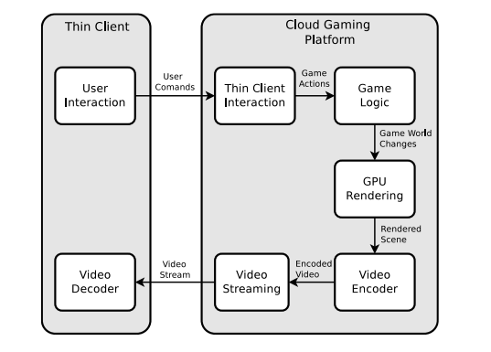
DESIGN AND IMPLEMENTATION
Architecture of Rhizome
Inspired by existing cloud gaming systems
Incorporates the latest advances of virtualization
Rhizome allows users and researchers to customize its subsystems

Slide 14
DESIGN AND IMPLEMENTATION
Remote server setup
Needs to setup remote desktop hooks
The commands are sent to the server over TCP
The rendering is performed by the GPU that is assigned to the VM
The media stream that is transmitted to the client undergoes several optimizations
Platform independent implementation
Tested on amazon EC2
Easily saleable
Rhizome platform capture video from the GPU and encode it using hardware H.264 encoder

Slide 15
DESIGN AND IMPLEMENTATION
Thin Client Configuration
Tests where done on EVGA Tegra NOTE 7 tablet
It was powered by NVIDIA Tegra 4 chipset and quad-core ARM Cortex-A15 CPU
With a NVIDIA GeForce GPU
Various benchmarking tests are done on the device
It was found that Hardware decoding is both performance and power efficient
The Rhizome client uses hardware encoding

Slide 16
Conclusion
Cloud gaming a the game changing technology
Efficient cloud can be achieved with the latest hardware and virtualization technology advances
Virtualization for GPU has greatly improved and is ready for gaming over a public cloud
Only hardware encoders can achieve acceptable gaming performance
Cloud gaming is rapidly evolving, particularly toward 4K UHD

Slide 17
Reference
M. Armbrust et al., “A view of cloud computing,” Commun. ACM, vol. 53, no. 4, pp. 50–58, 2010.
W. Cai, M. Chen, and V. C. M. Leung, “Toward gaming as a service,” IEEE Internet Comput., vol. 18, no. 3, pp. 12–18, May/Jun. 2014.
R. Shea, J. Liu, E. C.-H. Ngai, and Y. Cui, “Cloud gaming: Architecture and performance,” IEEE Netw., vol. 27, no. 4, pp. 16–21, Jul./Aug. 2013.
M. Claypool, D. Finkel, A. Grant, and M. Solano, “On the perfor-mance of OnLive thin client games,”
C.-Y. Huang, C.-H. Hsu, Y.-C. Chang, and K.-T. Chen, “GamingAnywhere: An open cloud gaming system,”
ACM Multimedia Syst. Conf. (MMSys), 2013, pp. 36–47. [Online].
Available: http://doi.acm.org/10.1145/2483977.2483981
OnLive. [Online]. Available: http://www.onlive.com/, accessed Sep. 2014.
Gaikai. [Online]. Available: http://www.gaikai.com/, accessed Sep. 2014.

Slide 18
Thank You!
Questions ???

